Slide 1
Do labor market opportunities affect young women’s work and family decisions?
Experimental evidence from India
Robert Jensen

Slide 2

INTRODUCTION
Getting married
Having children
VS
School
Entering the labor market (few well-paying jobs)

Slide 3
FACTS
17
Median age at marriage
19
Median age at first birth
(1975~1985)
4.3
Avg. children in lifetime

Slide 4
SELF EMPLOYMENT
Not require delays in marriage or fertility
Not require typical human capital investment

Slide 5
Business Process Outsourcing
Call centers
Data entry and management
Claims Processing
Secretarial services
Transcription
Online technical support
Accounting
Software development etc.

Slide 6
Business Process Outsourcing
69% frontline call center workers are women
Among 17 countries
45% in India
(Holman, Batt, and Ursula 2007)
17% among all industries(2010)
19.5% (2012)
(World Bank)

Slide 7
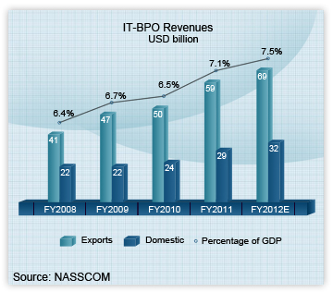

Slide 8
BPO
Requirement:
10~12 years of schooling at least
Recruiting characteristics:
Private contractors and subcontractors
Geographically concentrated:
95% in seven major cities

Slide 9
BPO
Starting salaries with no experience:
5,000~10,000 rupees (US$110~220)
per month (2003)
Twice the average pay for non-BPO workers
With similar education
Less social stigma (safer, “cleaner”)
(several studies)

Slide 10
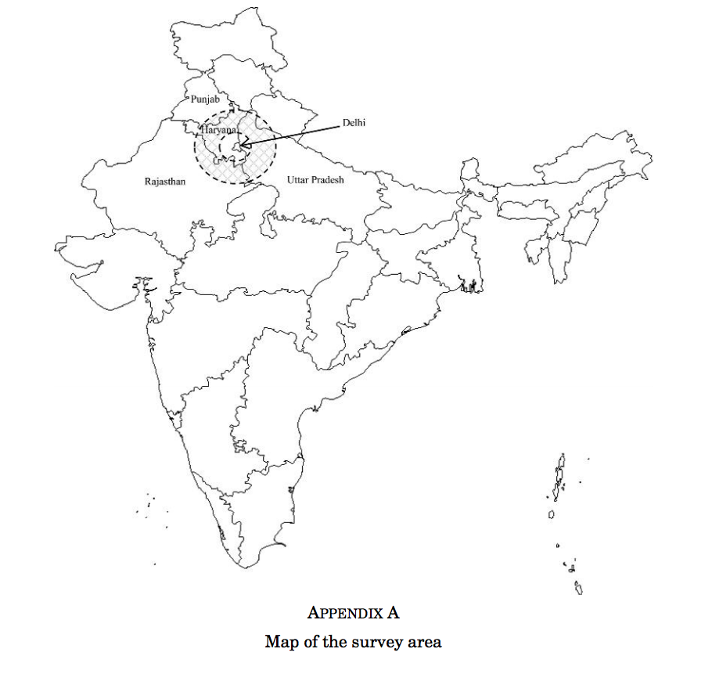
EXPERIMENT DESIGN

Slide 11
EXPERIMENT DESIGN
Treatment:
Information session
Job application strategies
Interview skills lessons
Mock interview
Recruiting session
Ongoing support
(3 rounds, 3 years)

Slide 12
EXPERIMENT DESIGN
Household survey
20 randomly selected households
per village (160 in total)
Independent from the treatment
Coverage:
91% round 1
94% round 2

Slide 13
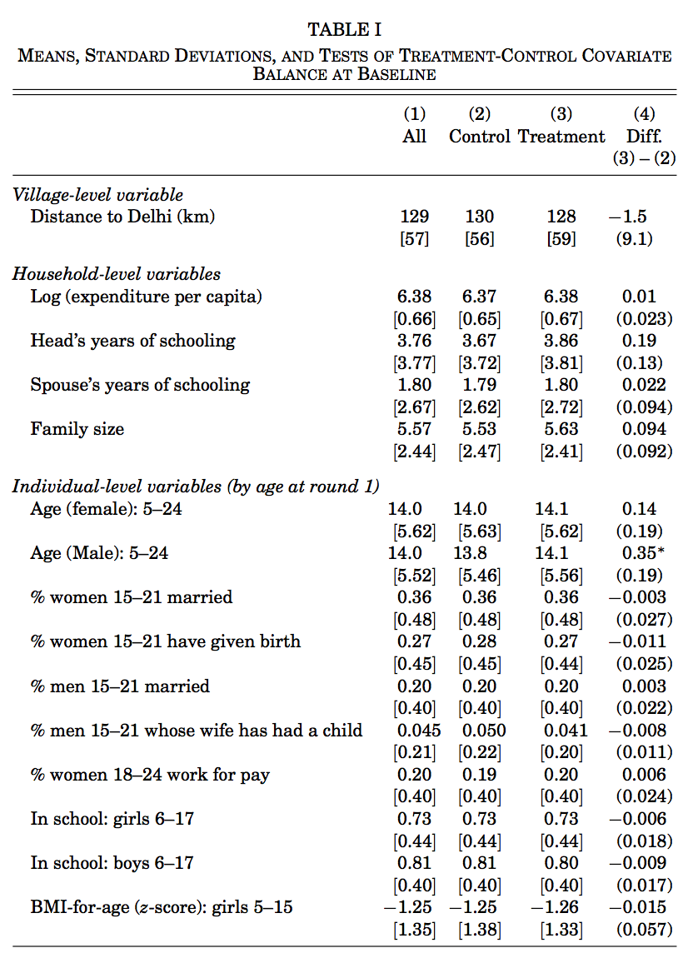

Slide 14
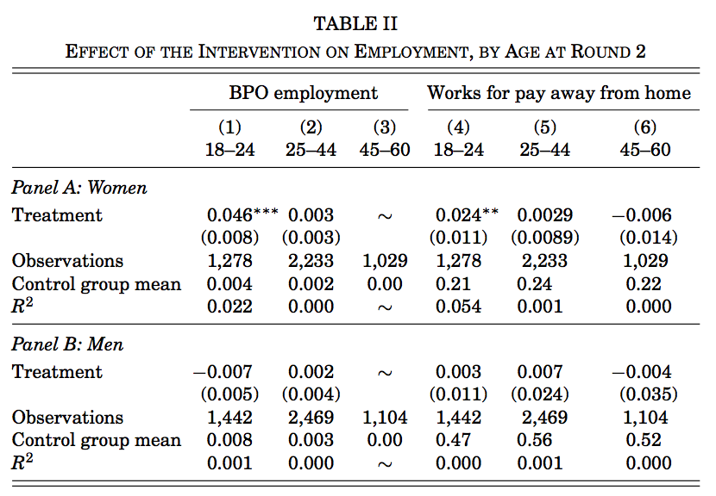
RESULTS
As only 28% qualified

Slide 15
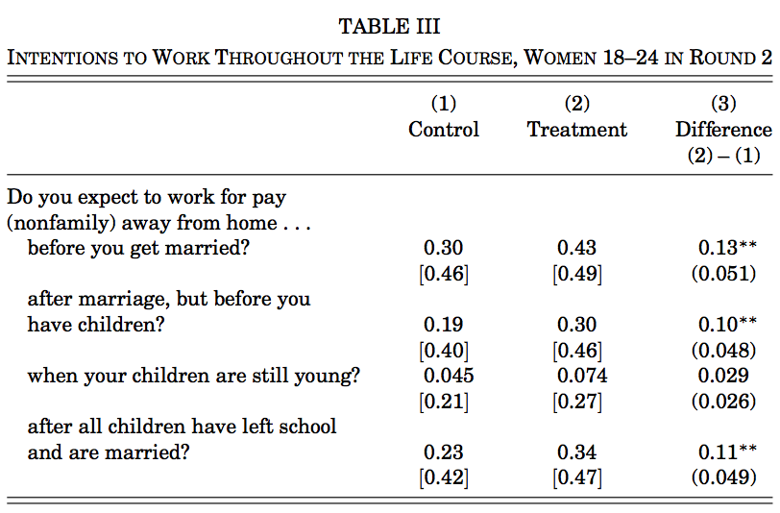
WORK EXPECTATION

Slide 16
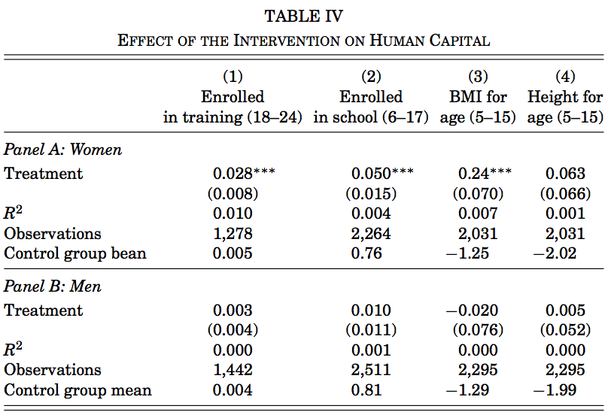
HUMAN CAPITAL

Slide 17
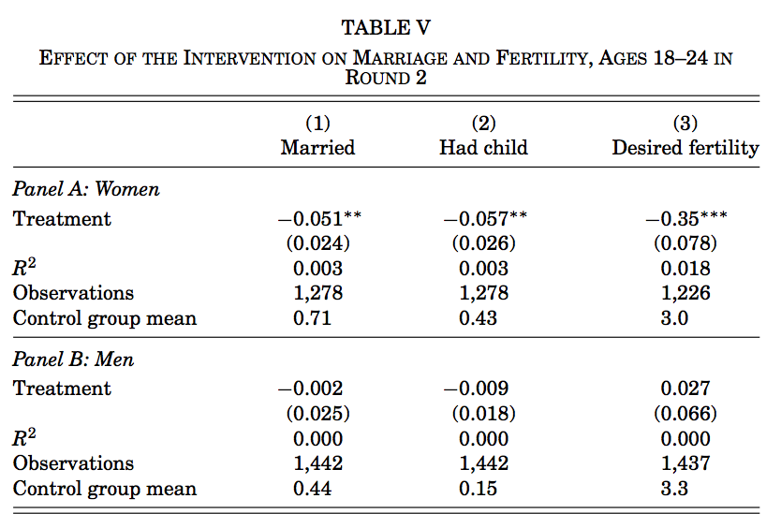
MARRIAGE AND FERTILITY

Slide 18
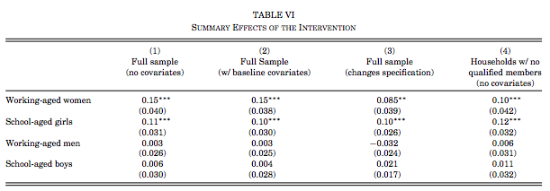
SUMMARY

Slide 19
OTHER MECHANISMS
Employment of mother:
More control in the family
Income effects
Allocation of time
Parents’ fertility

Slide 20
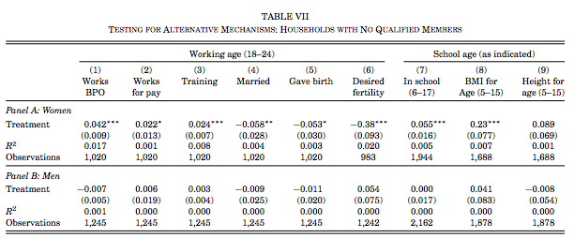

Slide 21
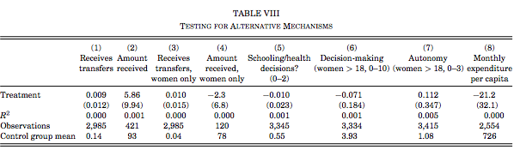

Slide 22
POLICY SUGGESTION
Awareness raising
Information
Media strategies
They are difficult to work, but
labor market underpinning will.

